Slide 1
HIT Songs Prediction
WIth Spotify API
Group: CPGD
50.038
Chen Yan 1003620
Dong Ke 1003713
Pang Luying 1003631
Gladys Chua Shi Ying 1003585

Slide 2
TABLE OF CONTENTS
04
01
02
03
05
06
Evaluation Methodology
Introduction,Dataset and Collection
Data processing
Problem and Algorithm
DEMO
Results and Discussion

Slide 3
Introduction
When we listen to songs, despite the different taste in music, one can more or less deduce whether a song will be popular. However, rather than using our intuition or "gut-feeling" to predict hit songs, the purpose of the project is to see if we can use intrinsic music data to identify Hit songs using machine learning.
This project is very meaningful as Hit Song Science can help music producers and artists get to know their audience better and produce songs that their fans would love to hear by tweaking intrinsic music qualities to make a song more popular catchy and likable. Additionally, it could help the agents to discover underground artists that has a higher chance to gain recognition.

Slide 4
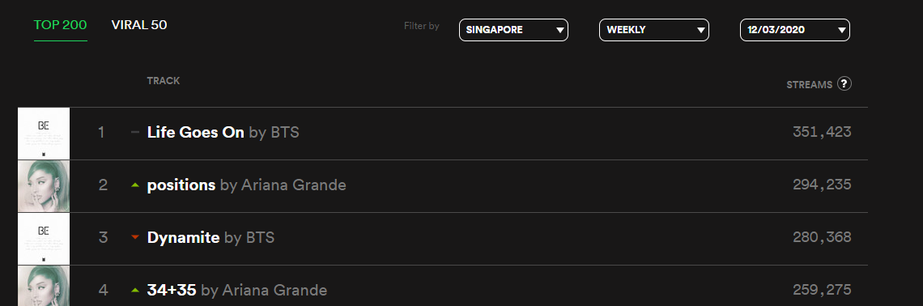
Dataset Collection
The music dataset is scrapped from Spotify weekly music chart from 2019 to 2020 and stored in csv. We then load the data into a pandas dataframe, and split the dataset into training data and testing data.
The dataset is originally in the data folder with csv files. We get the URL of the track and the rank of songs from the csv files. Then, we proceed to extract music features using the Spotify API according to the URL obtained.

Slide 5
Data Preprocessing
duration_ms
key
mode
The duration of the track in milliseconds.
The estimated overall key of the track. Integers map to pitches using standard Pitch Class notation.
Mode indicates the modality (major or minor) of a track
time_signature
acousticness
danceability
A notational convention to specify how many beats are in each bar (or measure)
A confidence measure from 0.0 to 1.0 of whether the track is acoustic
Danceability describes how suitable a track is for dancing

Slide 6
Data Preprocessing
loudness
instrumentalness
liveness
The overall loudness of a track in decibels (dB).
Predicts whether a track contains no vocals.
Detects the presence of an audience in the recording.
energy
speechness
valence
Energy is a measure from 0.0 to 1.0 and represents a perceptual measure of intensity and activity.
Speechiness detects the presence of spoken words in a track.
A measure from 0.0 to 1.0 describing the musical positiveness conveyed by a track.

Slide 7
03
Problem & Algorithem
Notes:
we will show the result of knn, adaboost, random forest and talk a bit of the cnn. we have tried some other models but these models give higher performance than others. but for cnn, we did not get a really good result of cnn.

Slide 8
Algorithm
Decision trees
Gaussian Naive Bayes
Random Forest
Adabosst classfier
LR
SVM
KNN
CNN

Slide 9
04
models
KNN
Ensemble Learnig Model
CNN
Notes:
we will show the result of knn, adaboost, random forest and talk a bit of the cnn. we have tried some other models but these models give higher performance than others. but for cnn, we did not get a really good result of cnn.

Slide 10
Evaluation
Confusion matrix: shows true posivive, true negative, false positive, false negative
Precision: show how precise/accurate the model is out of those predicted positive.
Recall: ratio of correctly predicted positive (True Positives) to actual positive, It shows proportion of actual positives that is identified correctly
F1-score: weighted average (or harmonic mean) of Precision and Recall
Receiver Operating Characteristics (ROC): constructed by plotting the true positive rate (TPR) against the false positive rate (FPR).
Area Under the Curve (AUC): represents degree or measure of separability. It tells how much the model is capable of distinguishing between classes. Higher the AUC, better the model is at predicting 0’s as 0’s and 1’s as 1’s
Notes:
for the evalution, we will get all these results after make preditions of validation dataset. Here we will take a look at ROC graph and AUC value for evaluation of each model.
AUC - ROC curve is a performance measurement for classification problem at various thresholds settings. ROC is a probability curve and AUC represents degree or measure of separability. It tells how much model is capable of distinguishing between classes. Higher the AUC, better the model is at predicting 0s as 0s and 1s as 1s. By analogy, Higher the AUC, better the model is at distinguishing between patients with disease and no disease.
A confusion matrix is a table that is often used to describe the performance of a classification model on a set of test data for which the true values are known.
ROC; Shows the trade-off between sensitivity (or TPR) and specificity (1 – FPR). Classifiers that give curves closer to the top-left corner indicate a better performance.

Slide 11
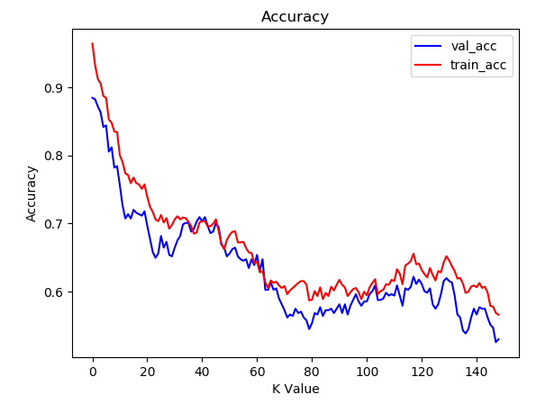
: Decide K value
K Nearest Neighbor
Plot out graphs of training accuracy and validation accuracy for different k value.
Found out the value around 40 is suitable for our model as the model gives similar accuracy for both validation set and validation set.
Build our KNN model with k=39 , which is approximate to the square root of total samples (1560)
Notes:
for knn model we should decide what k value we should choose for the knn model. how we choose it is that we plot out the graph of training accuracy and validation accuracy and find the range where it can give high accuracy for both. from the graph we can k value around 40 is more general for both training and validation dataset as they have similar accuracy which is around 70%. we we choose the k to be 39 which is approximate to the square root value of the total number of samples

Slide 12
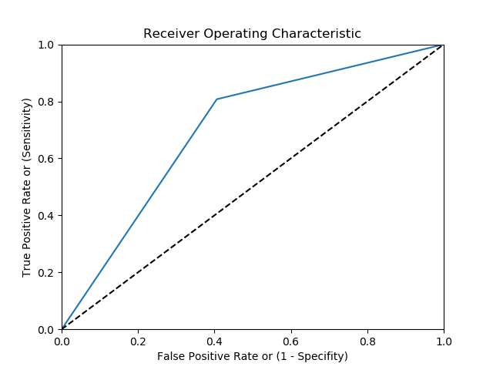
: Predict Result
K Nearest Neighbor
AUC:0.7007089218176171 > 0.5
The model has a fair ability (0.70) to perform classification
Graph shows around 0.8 true positive rate and 0.4 false positive rate
Accuracy=0.70, there is around 0.70 probability of clasifying the input correctly
Notes:
Chenyan

Slide 13
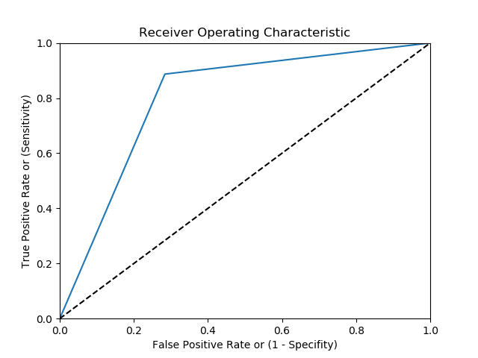
AdaBoost
Parameters: Number of estimators =1000 Learnig rate = 0.1
Training accuracy: 0.8782051282051282
AUC: 0.8015932469715518 > 0.5
The model has good ability (0.80) to perform classification
Graph shows around 0.9 true positive rate and 0.3 false positive rate
Accuracy = 0.80 , there is around 0.80 probability of clasifying the input correctly
Notes:
Ensemble learning, in general, is a model that makes predictions based on a number of different models.
Boosting model’s key is learning from the previous mistakes, adaBoost learns from the mistakes by increasing the weight of misclassified data points.

Slide 14
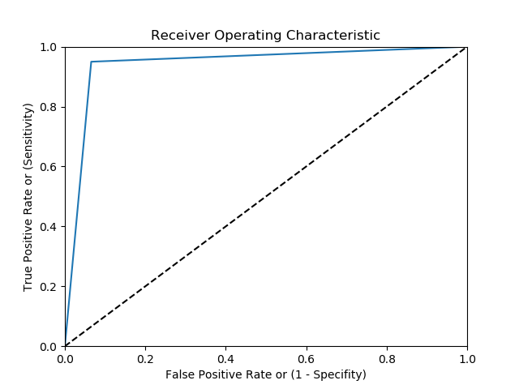
Random Forest
Parameters: Number of estimators =100
Training accuracy: 0.9734432234432234
AUC: 0.9249511245911823 > 0.5
The model has good ability (0.92) to perform classification
Graph shows around 0.95 true positive rate and 0.1 false positive rate
Accuracy = 0.93 , there is around 0.93 probability of clasifying the input correctly
Notes:
Bagging: Training a bunch of individual models in a parallel way. Each model is trained by a random subset of the data
Random forest is an ensemble model using bagging as the ensemble method and decision tree as the individual model.

Slide 15
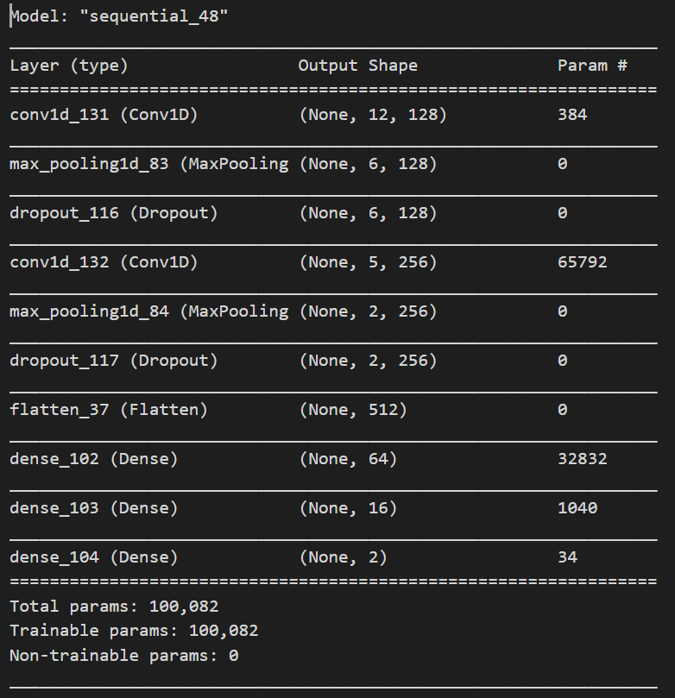
: model layers
CNN
Each layer has a 1D convolutional layer, a pooling layer and a dropout layer
Activation function: relu, softmax Optimizer: Adadelta Epochs=20 Batch size=20
Input normalized x and binary matrices y
Notes:
Feature extraction is performed by alternating convolution layers with subsampling layers. Classification is performed with dense layers followed by a final softmax layer.

Slide 16
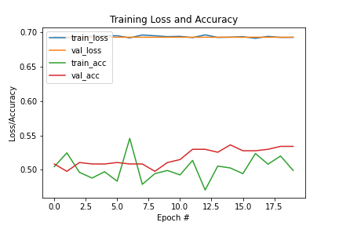
: Training Result
CNN
Training loss and validation loss of each epoch are similar, which are around 0.69
Valitaion accuracy is a bit higher than training accuracy.

Slide 17
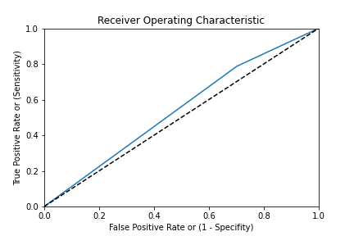
: Predict Result
CNN
AUC: 0.5425656403130257 ≈ 0.5
The model has bad ability (0.54) to perform classification
Graph shows around 0.80 true positive rate and 0.65 false positive rate
Accuracy = 0.53 , there is around 0.53 probability of clasifying the input correctly
Notes:
Chenyan

Slide 18
05
Results
We reported the AUC,accuracy, precision and recall for each model, but we mainly focused on the f1-score to analyse results.
Notes:
Chenyan

Slide 19
Model Results
 | LR | RF | SVM | DT | KNN | Gaussian Naiva Bayes | Adaboost Classfier | CNN
AUC | 0.64 | 0.92 | 0.62 | 0.60 | 0.70 | 0.56 | 0.80 | 0.54
Accuracy | 0.64 | 0.92 | 0.62 | 0.60 | 0.70 | 0.56 | 0.80 | 0.53
Precision | 0.63 | 0.92 | 0.61 | 0.60 | 0.67 | 0.63 | 0.77 | 0.51
Recall | 0.71 | 0.92 | 0.69 | 0.69 | 0.81 | 0.81 | 0.89 | 0.79
F1-score | 0.67 | 0.92 | 0.65 | 0.64 | 0.74 | 0.42 | 0.82 | 0.62

Slide 20
05
Discussion
&
Improvements
We chose the top 3 successful algorithms Random Forest, AdaboostClassifier and K Nearest Neighbor Classifier (KNN) for further investigation.

Slide 21
Discussion & Improvements
In order to get better results, we chose the top 3 successful algorithms for further investigation:
Random Forest
AdaboostClassifier
K Nearest Neighbor Classifier (KNN)
We select the top 7 features(half of total numbers of features) for each algorithm by looking at how much the tree nodes that use that feature reduce impurity across all trees in the forest.
Notes:
Here is the comparison result between training with features and without features selected on these models.

Slide 22
Further investigation
 | RF |  | KNN |  | Adaboost Classfier
 | Without FS | With FS | Without FS | With FS | Without FS | With FS
AUC | 0.92 | 0.916 | 0.70 | 0.916 | 0.80 | 0.811
Accuracy | 0.92 | 0.910 | 0.70 | 0.920 | 0.80 | 0.810
Precision | 0.92 | 0.930 | 0.67 | 0.910 | 0.77 | 0.790
Recall | 0.92 | 0.920 | 0.81 | 0.930 | 0.89 | 0.850
F1-score | 0.92 | 0.920 | 0.74 | 0.920 | 0.82 | 0.820
Notes:
For the KNN algorithm, we found the f1-score of the model with features (0.92) is higher than the model without features selected(0.74). Others have similar f1-score between with features selected and without features selected. The results of RF and Adaboost Classifier features selected the model unchanged may be because our dataset is quite general. Therefore, although these selected features is more importance, it cannot predict hit or non-hit songs

Slide 23
Conclusion & Future work

Slide 24
Conclusion
In conclusion, we got a very high f1-score and accuracy in the Random Forest model. To some extent, it’s enough to predict hit songs in general.
However, we still have to do further works to predict songs better. In this project, we found it’s quite difficult to define hit or non-hit due to the trends in hit music changing over time. In addition, the current model that we have is very general, we will classify the hit and non-hit songs more thoroughly in future works.
In future experiments we would like to use more data to reduce variability of results, select good quality data and consider more factors that affect prediction results.

Slide 25
Future works
Data based
Time based
Split songs to different genres
Get data from audio itself
social media trends
popularity of the artist
Notes:
Split songs to different genres
The features between hit and non-hit from different genres may be on the different ends of a spectrum. The features may contrast to each other in different genres.Therefore, we may split hit or non-hit songs into their genre and build a model for each genre to perform error analysis for some successful algorithms to select the greatest influence features to train our model. (It would be better to classify the songs into different genres before we model them as some genres are distinct from one another, hence modelling them together might make our model confused about the features of a hit song [basically, different genres have different features that makes them a hit song. so, it’s best to narrow down the scope to cater for each genre])
Get data from audio itself
From another perspective, we also can predict hit or non-hit songs by audio itself.(eg. tone,pitch,Intonation，Music effect).It is also meaningful to define hit-songs lyrics. Apply more types of high level features for training to make even better predictions.
(Time based) investigate in future
social media trends
The trends in hit music change over time with the effect of social media trends.We may focus on finding a way or dividing the data into several subsets of year periods for training models in the future.
popularity of the artist
When popular artists produce a new song or new album, their fans will support them no matter the quality of the song.Hence, a model can be made to detect if the song is a hit song after the first hype of the song?Trying to use combined audio itself with artist past-performance may help us to explain a majority of the variance of the data.

Slide 26
06
UI DEMO
Streamlit.io

Slide 27
Problem
“This project aims to predict hit songs to see if we can use intrinsic music data to identify Hit songs by machine learning. Hit song prediction Collate a dataset of hit songs from popular charts. We defined the top 15 as hit-song and bottom 15 as non-hits and use different machine learning algorithms to train models with a select dataset within one year from Spotify API. ”

